Slide 1

Cab Allocation System
(Using linked list)

Slide 2

Group Members
Name Registration Number
Mayank Verma 15BCE0032
Vishal Bhaskar 15BCE0048

Slide 3

Introduction
We all are aware of cab booking system and we use it in our day to day life. Here, in this project we are willing to do the same but by using linked list. Our prime objective is to data storage and management using linked list.

Slide 4

Data-Structure Used
LINKED LIST-
In computer science, a linked list is a linear collection of data elements, called nodes pointing to the next node by means of a pointer. It is a data structure consisting of a group of nodes which together represent a sequence. Under the simplest form, each node is composed of data and a reference (in other words, a link) to the next node in the sequence.

Slide 5

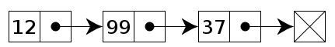
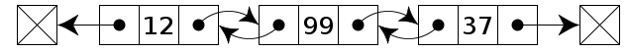
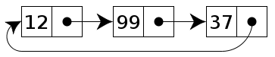
Different Types of Linked List
Singly Linked List
Doubly Linked List
Circular Linked List

Slide 6

Abstract
In this project we want to make a data management system for traveler association using doubly linked list. Here the user will be allowed to login as a customer or server (driver). Then, as a customer he can check the availability of a vehicle and thus book it. As a server he can give information to database when he is booked (and the place to which he is going) or when he reaches back after finishing a task. Therefore, we would be able to solve the problem of non availability and improper management of car. The user can also opt for car pooling also.

Slide 7

INTERFACES
ADMIN
USER
CAB DRIVER

Slide 8
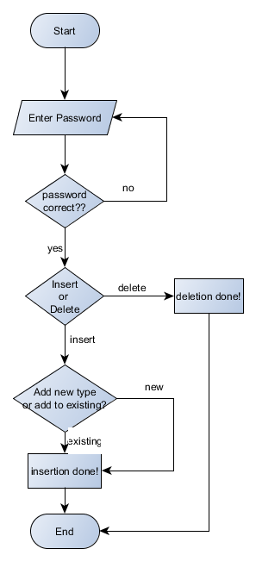
ADMIN INTERFACE:

Slide 9
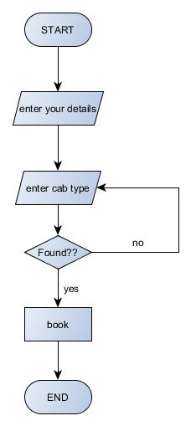
USER INTERFACE:

Slide 10
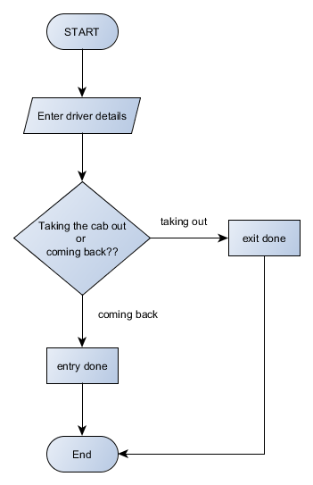
DRIVER INTERFACE:

